Slide 1
.NET
An “Application Development Platform”.
It is developed by Microsoft Corporation in the year 2000.
.NET Stands for Network Enabled Technology.
.NET is a Package or SDK or Framework also called as ".NET Framework".
Used for powerful software application development.
It provides necessary environment (Languages,compilers, run time engines, libraries) for developing efficient and powerful applications for the end-users.
.NET provides a distributed object oriented platform for building
Stand-alone Applications(Console & Winforms)
Web-based Applications
Mobile-applications
Webservices

Slide 2
.NET FRAMEWORK
.NET Framework is a set of components, which are essential for develop any application in .NET Environment.
.NET Framework is a common Architecture for all .NET Applications.
.NET Framework Consist of following Components.
Languages
Technologies
Base Class Libraries
CLR[Common Language Runtime]

Slide 3
.NET Framework Architecture
VC#.NET
VB.NET
VC++.NET
F#.Net
Common Language Specification
Win Forms
Web Forms
Win Services
…..
.NET Framework
ADO.NET
Base Class Library
Common Language Runtime
Operating System

Slide 4
Languages
.NET gives choice of languages includes VB.NET, C#, F#, VC++ for developing diff kind on Applications. All of these compile to a Common Intermediate language.

Slide 5
MSIL
MSIL stands for Microsoft Intermediate Language.
On compiling any .NET language, you will get MSIL.
Ex: C#.NET MSIL
Ex: VB.NET MSIL
Ex: VC++.NET MSIL
MSIL is a compile code of any .NET Language.
Also Called as Common Intermediate Language or Assembly.
Its file extension can be either ".exe" or ".dll".
EXE file are directly executable files.
A DLL file shares the common code among many projects.
CSC
VBC
VCC
.cs/.vb
CSC/VBC
MSIL

Slide 6
CLR
Common Language Runtime is the core component for .NET framework
CLR is Common Runtime Engine for all .NET Applications
All the .NET program execution is managed by CLR.
CLR uses Just-In-Time (JIT) compiler to compile CIL code into the machine understandable code(Native code).
.cs/.vb
CSC/VBC
MSIL
CLR
Native Code

Slide 7
Common Runtime Engine and CIL(Compilation Model)
.NET compilation model
VB.NET.C#/J#/C++ Code
.NET compatible languages compile to a platform-neutral language called Common Intermediate Language(CIL)
Compiler
Common Intermediate Language
The platform-specific CLR compiles CIL to machine-readable code that can be executed on the current platform
Common Language Runtime
01101100101011
10010101100110

Slide 8
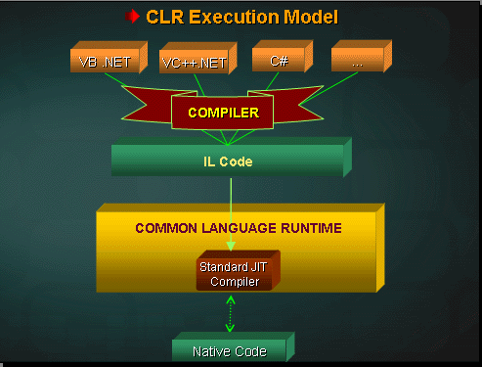

Slide 9
Base Class Libraries
Base Class Libraries are Standard Libraries common to all .NET languages.
Base Class Libraries provides some set of Common classes , which are useful for development of .NET applications.
Base Class Libraries are Predefined Libraries comes with .NET framework
All Base class Libraries are in the form of .dll(dynamic link libraries)
The Base class Libraries also called Assemblies or Namespaces.

Slide 10
Base Class Libraries
Important DLL files of BCL
System.IO.dll-work with filels and Directories
System.Threading.dll-base library for Threading
System.Data.dll-base library for Ado.net
System.Web.dll -base library for Asp.net
Note: System is the Base Library in .Net Framework.
Adding a Library to the Application
using System. Web----------C#
Imports System.Web----------VB.net

Slide 11

Core Features of .NET Framework
Language Independence
Multi Application Support
Multi Server Support
Common CLR to All the Languages.
Common Intermediate Language CIL(MSIL)
Base Class Library
Interoperability
Data Access
Web Application Development
Memory Management

Slide 12
Visual Studio
IDE for creating .NET applications which are
Console based
Web based
Windows form based
Web services
Features
Page design
Automatic error detection
Debugging tools
IntelliSense (IntelliSense helps in auto completion by providing functions/methods names parameters etc.)
.

Slide 13

Visual Studio
Visual Studio 6.0
Visual Studio .NET (2002)
Visual Studio .NET 2003
Visual Studio 2005
Visual Studio 2008
Visual Studio 2010
Visual Studio 2012
Visual Studio 2013
Visual Studio 2015
Visual Studio 2017
Visual Studio 2019
Visual Studio 2022

Slide 14
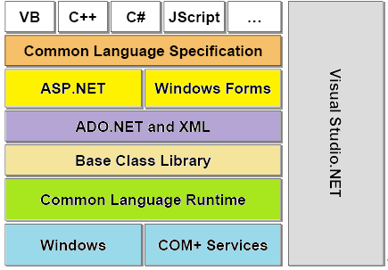

Slide 15

.NET framework versions
NET Framework 4.8
.NET Framework 4.7.2
.NET Framework 4.7.1
.NET Framework 4.7
.NET Framework 4.6.2
.NET Framework 4.6.1
.NET Framework 4.6
.NET Framework 4.5.2
.NET Framework 4.5.1
.NET Framework 4.5
.NET Framework 4
.NET Framework 3.5
.NET Framework 3.0
.NET Framework 2.0
.NET Framework 1.1
.NET Framework 1.0

Slide 16

Environment setup
Windows Platform
Visual Studio.NET
SQL Server
Web Server

Slide 17
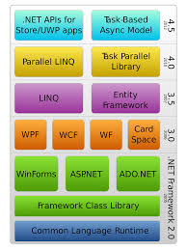

Notes:
Universal Windows Platform (UWP) apps - MSDN - Microsoft

